Slide 1


Testing for Weak-Form Efficiency
By Ananya Agrawal, Honggang Yan , Kirtesh Pushpakbhai Patel, Rhushikesh Bhosale
10 March 2023

Slide 2



Content
INTRODUCTION
INTRODUCTION
MODELS
CONCLUSION
Project Overview
Project Workflow
Data
Statistical Test
ARIMA & SARIMX
LSTM

Slide 3

Introduction

Slide 4
Project overview
INTRODUCTION
Project Background
According to weak-form market efficiency, prices should already reflect all information of past prices and volume. It should thus not be possible to predict future returns based on their historical time series. Accordingly, prices should behave like a random walk.
Many different tests have been proposed to study return predictability, for example with respect to autocorrelation, variance ratios, runs test.
Project Goal: Testing for Weak-Form Efficiency
The aim of this project is to empirically study return predictability in a market of your choice (equity, fixed income, mutual funds, ESG or green investments, FX, crypto, …) using multiple approaches and statistical tests. Depending on the market chosen, interesting questions would be whether the degree of price efficiency changes over time or across countries or depends on the sampling frequency or other factors.

Slide 5
Market efficiency
INTRODUCTION
Market Efficiency : Prices reflect all available information
Weak Efficiency
Semi Strong Efficiency
Strong Efficiency
Public information about past prices is reflected in current prices
Public information about past prices is reflected in current prices.
All relevant and publicly available information is reflected in current prices.
Public information about past prices is reflected in current prices.
All relevant and publicly available information is reflected in current prices.
Private information (held by insiders) is reflected in current prices
All public information plus inside or private information
All public information
Information in past prices

Slide 6
EFFICIENT MARKET HYPOTHESIS
INTRODUCTION
Insider trading will not work
Market prices unlikely to reflect private information
(due to insider trading laws)
STRONG-FORM
Fundamental Analysis will not work
Markets are generally semi-strong form efficient
(except emerging markets)
SEMI STRONG-FORM
Technical Analysis
will not work
Markets are generally weak-form efficient
(except emerging markets)
WEAK-FORM

Slide 7
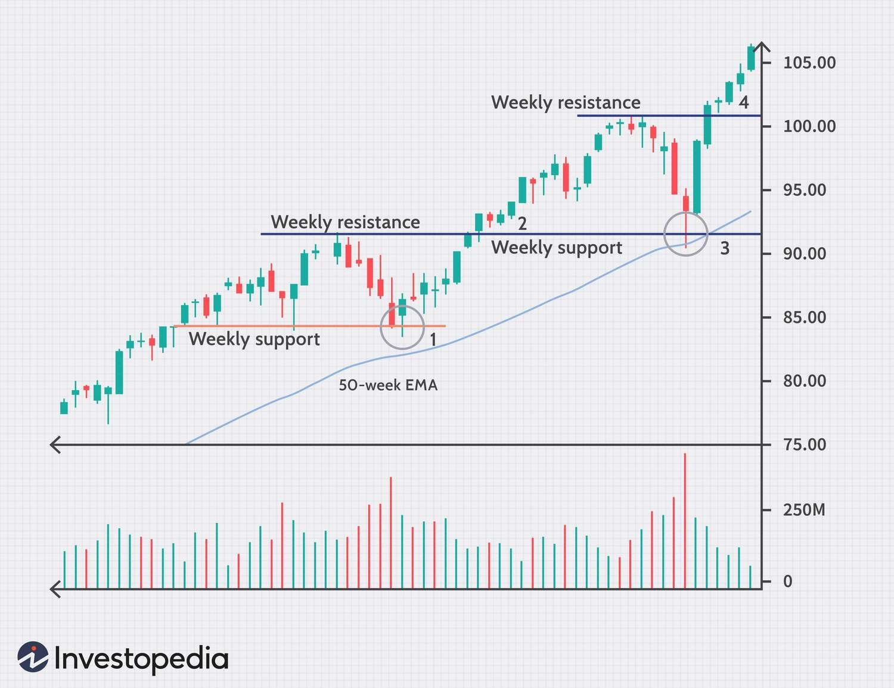
Weak form efficiency
INTRODUCTION
He may assume he can profit if he buys the stock at the beginning of the week and sells at the end of the week.
David is a swing trader
Identifies a pattern in weekly chart for Alphabet Inc.
If, however, Alphabet’s price declines on Monday but does not increase on Friday,
the market is considered weak form efficient.

Slide 8
PROJECT WORKFLOW
INTRODUCTION
Data Acquisition &
Preparation
Statistical Models
ARIMA / SARIMA
LSTM
Implementation
Model Training
Model Training
Validation
Validation
COMPARISON

Slide 9
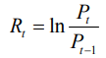
Data
INTRODUCTION
The descriptive statistics
The log-return applied
in the daily prices
2011-01-01 — 2015-12-31
 | count | mean | std | min | max | Skewness | Kurtosis
US : S&P500 | 1256 | 0.0004 | 0.0098 | -0.069 | 0.0463 | -0.1535 | 1.5281
India : Nifty-50 | 1213 | 0.0002 | 0.0108 | -0.061 | 0.0374 | -0.5078 | 4.9383
1. US : S&P500
1) 2011-01-01 — 2015-12-31
2) 2018-01-01 — 2022-12-31
2. India : Nifty-50
1) 2011-01-01 — 2015-12-31
2) 2018-01-01 — 2022-12-31
2018-01-01 — 2022-12-31
 | count | mean | std | min | max | Skewness | Kurtosis
US : S&P500 | 1258 | 0.0003 | 0.0138 | -0.1277 | 0.0897 | -0.7915 | 12.9480
India : Nifty-50 | 1231 | 0.0004 | 0.0124 | -0.1390 | 0.0840 | -1.5164 | 20.0383

Slide 10
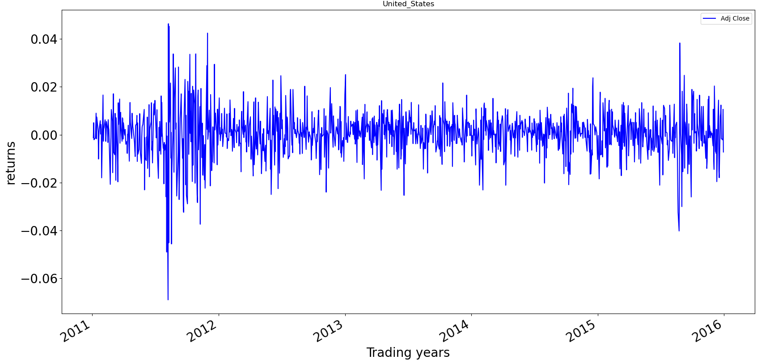
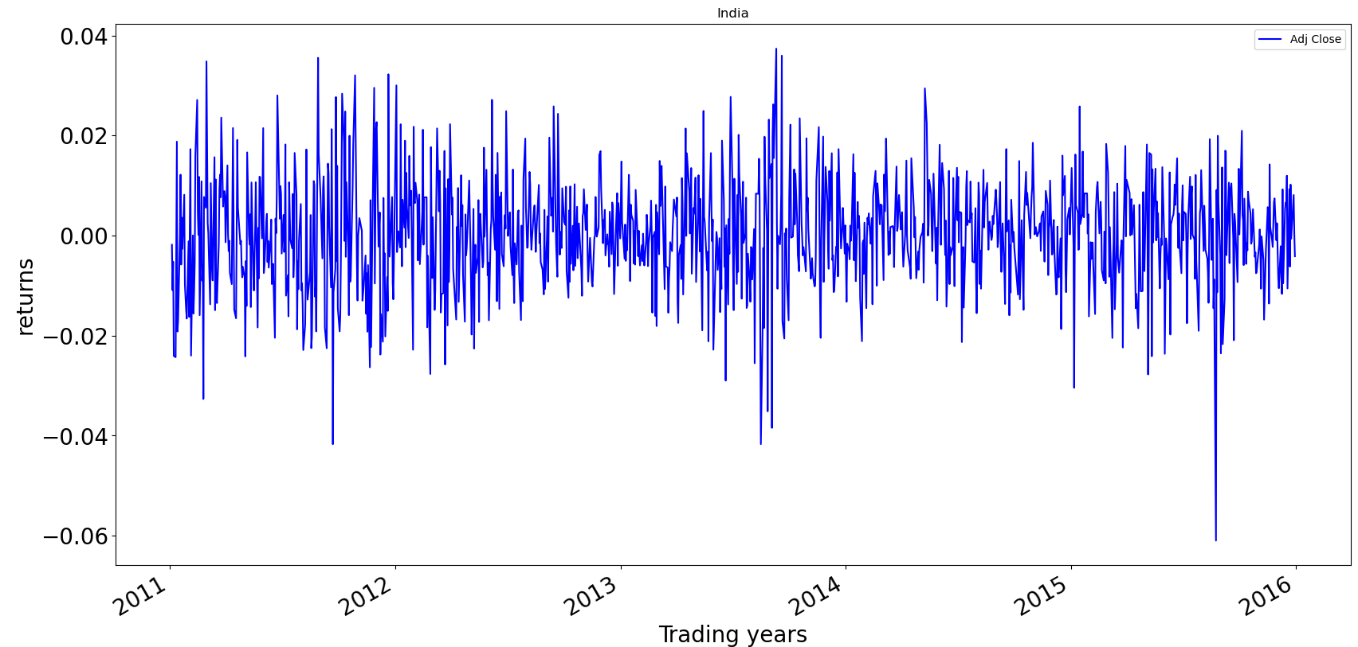
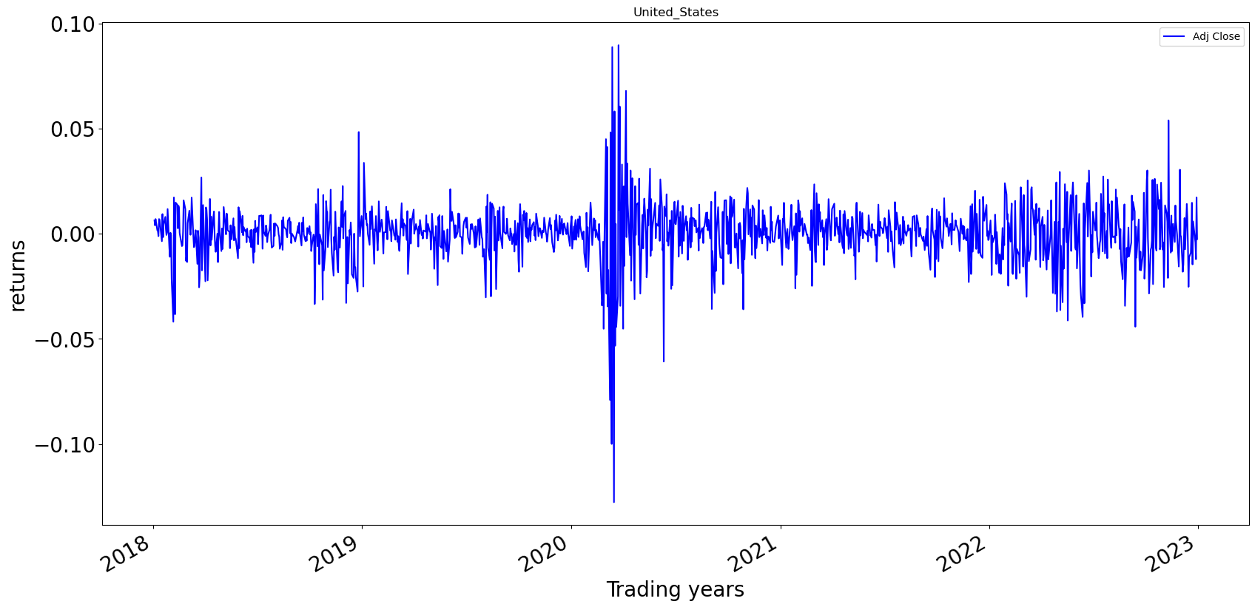
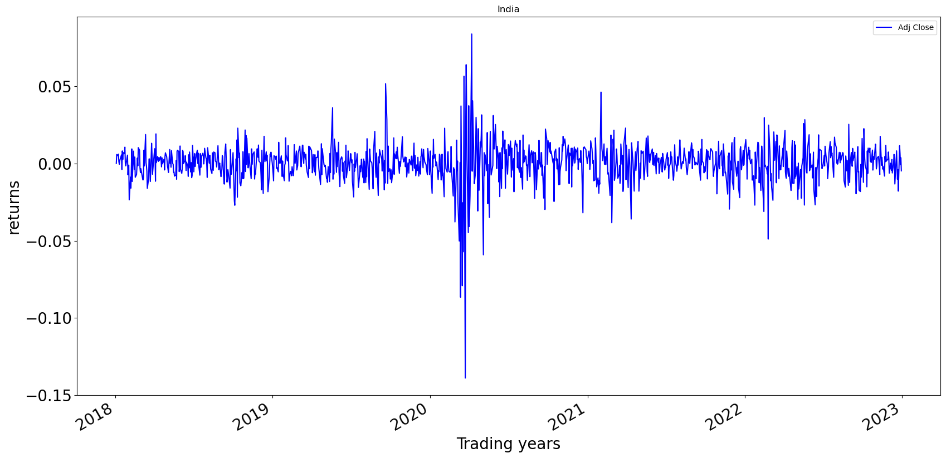
Data visualization
INTRODUCTION
Stock Market Return Visualization
US : S&P500
1st period
India : Nifty-50
1st period
2nd period
2nd period

Slide 11

Model

Slide 12
MODEL
MODEL OVERVIEW
Statistical Tests
Prediction Model
Autocorrelation
ARIMA & SARIMAX
Runs Test
LSTM
Variance Ratio Test

Slide 13

Statistical test | Hypothesis
MODEL
In a market that complies with a random walk it is not possible to use information on past prices to predict future prices, the returns data should be serial independent.
The efficient market hypothesis (EMH) argues that bond prices reflect all available information and that investors cannot obtain anomalous profitability trading based on this information.
Efficient Market
Hypothesis
Mean-reverting
If the returns are negatively correlated the market is inefficient. The market is mean-reverting
Inefficient Market
Trending
If the returns are positively correlated the market is inefficient. The market is trending.

Slide 14
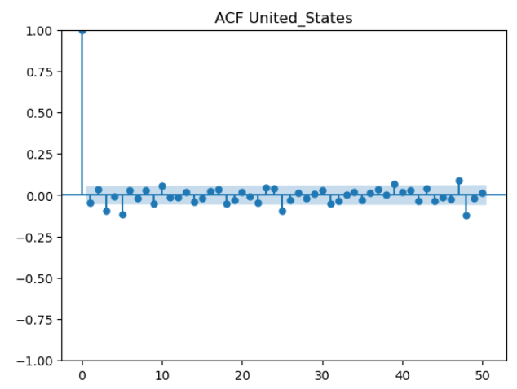
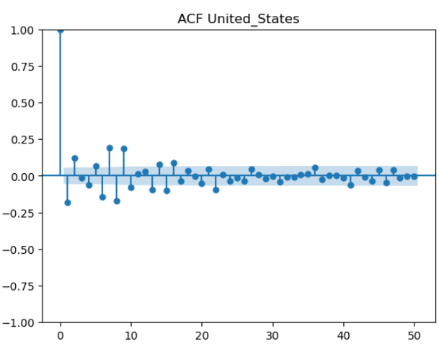
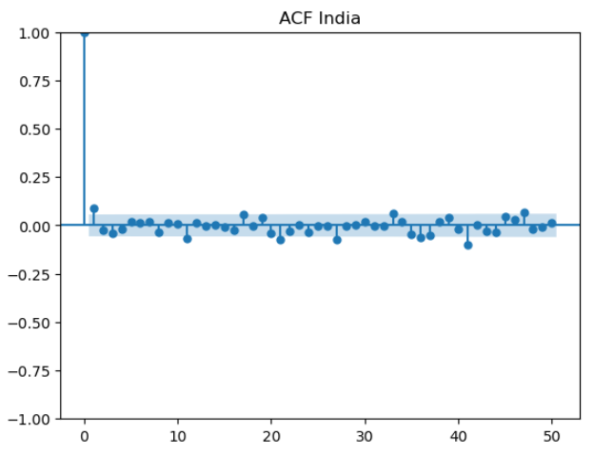
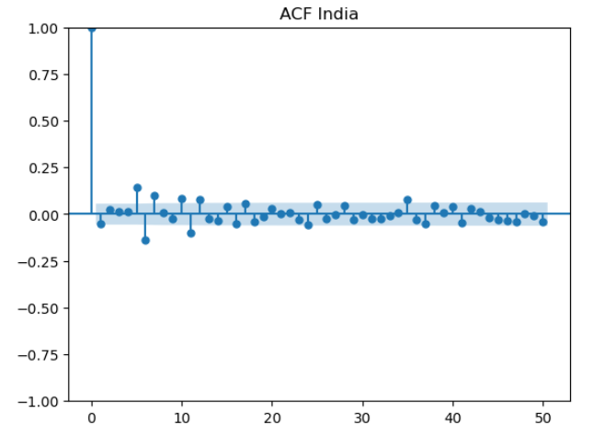
Statistical Test
MODEL
Autocorrelation Fuction
The autocorrelation function (ACF) defines how data points in a time series are related, on average, to the preceding data points
US : S&P500
India : Nifty-50
1st period
2nd period
1st period
2nd period

Slide 15
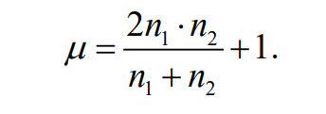
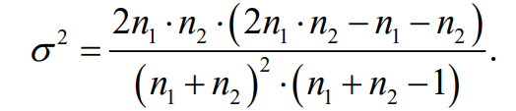
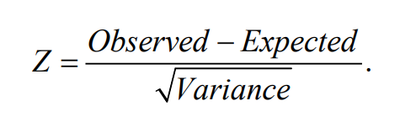
Statistical Test
MODEL
Runs Test
Run test: run test is a nonparametric test. It is a statistical procedure that examines whether a string of data is occurring randomly given a specific distribution . The run test analyses the occurrence of similar events that are separated by events that are different.
Runs Test
SIGNS: Returns to be converted to either a case of positive sign (+) or negative sign (−).
RUNS: Any consecutive returns of either sign of positive (+) or negative (−) is treated as a run.
Test: Compare the Observed runs and expected runs , and use P-value to test the random walk Hypotheses
The mean and variance of runs is calculated as follows:
The standard normal Z-statistic used to conduct a run test is given by:
If observed runs is larger than expected runs, the market tends to be mean-reverting;
If observed runs is smaller than expected runs, the market tends to be trending.

Slide 16
Results
MODEL
Runs Test
Runs tests characterize the US: S&P500 index as a more mean-reverting market and India: Nifty-50 index be more trending .
India: Nifty-50 index is inefficient and returns tend to be trending (persistent) in both period.
US: S&P500 index is efficient and still can detect a mean-reverting trend in the runs .
Period | Market Index | Positve | Negative | Observed runs | Expected runs | Z-stat | P_value | Market Efficiency
2011-01-01 — 2015-12-31 | US: S&P500 | 679 | 577 | 635 | 624 | 0.575 | 0.56499 | Efficient
 | India : Nifty-50 | 617 | 595 | 549 | 606 | -3.318 | 0.00091 | Inefficient (trending)
2018-01-01 — 2022-12-31 | US: S&P500 | 677 | 581 | 644 | 626 | 1.001 | 0.31701 | Efficient
 | India : Nifty-50 | 668 | 563 | 550 | 612 | -3.557 | 0.00038 | Inefficient (trending)
P_value = 5% .

Slide 17
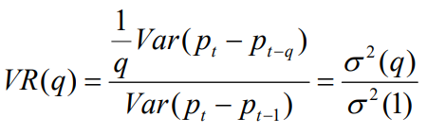
Statistical Test
MODEL
Variance Ratio Test
This method of the variance ratio test is based on the property of the variance of increments of a random walk. Therefore, if a time series follows a random walk process, the variance of its q-differences should be q times the variance of its first differences.
Variance Ratio Test
Assumption：linear relations in observation interval regarding the variance of increments of random walk. If the value of VR (q) is equal to 1, the null hypothesis will be accepted which means the time series data is a random walk.
Test: If the value of VR(q) is equal to 1, the null hypothesis will be accepted which means the time series data is a random walk.
The variance ratio is then denoted by :
under the null hypothesis VR(q) = 1
If variance ratio is larger than 1, the market tends to be trending;
If variance ratio is smaller than 1, the market tends to be mean-reverting.

Slide 18
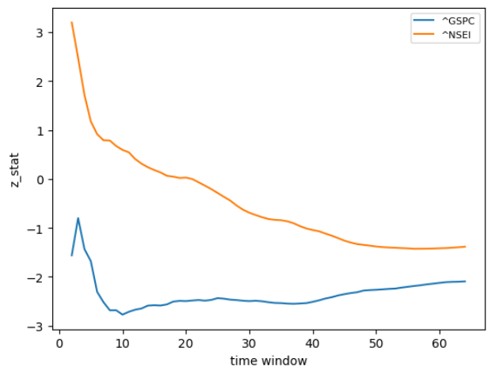
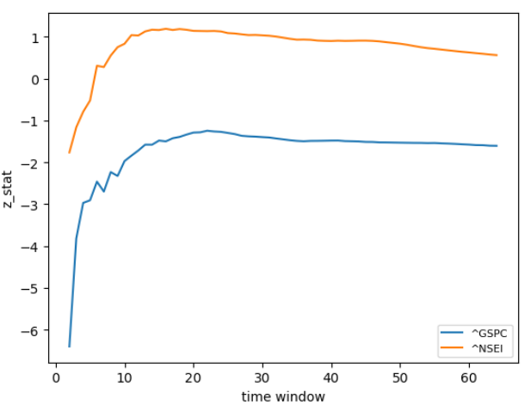
Results
MODEL
Variance Ratio Test
Period | Market Index | Chow_Denning_P_value | Max_Z_stat | P_value | Market Efficiency
2011-01-01 — 2015-12-31 | US: S&P500 | 0.29684 | -2.7718 | 0.00557 | Efficient
 | India : Nifty-50 | 0.08377 | 3.1972 | 0.00139 | Efficient
2018-01-01 — 2022-12-31 | US: S&P500 | 1.00E-08 | -6.3961 | 1.59E-10 | Inefficient(mean-reverting)
 | India : Nifty-50 | 0.99398 | -1.7627 | 0.07795 | Efficient
When Chow_Denning_P_value=5%.
US: S&P500 index is efficient in first period but be less efficient in second period , returns always have a mean-reverting trend.
India: Nifty-50 index is efficient in both period.

Slide 19
SARIMA | INTRODUCTION
MODEL
Seasonal Auto Regressive Integrated Moving Average
Auto Regressive Integrated Moving Average
Pre-processing
Autoregression (AR): This component models the relationship between an observation and a number of lagged observations.
Moving Average (MA): This component models the relationship between an observation and a number of lagged forecast errors.
Integration (I): This component models the difference between observations at two different points in time, helps to stabilize the mean of the time series.
Seasonality (S): The seasonal component includes the same three components as the non-seasonal component (AR, MA, and I), but with additional parameters to model the seasonal patterns.
Decompose Data
Stationary
Autocorrelation, Model order
Fit SARIMA / ARIMA model
Evaluate and improve model

Slide 20
MODEL
SARIMA | Model comparison NIFTY
NIFTY 2011 - 2015
NIFTY 2018 - 2022
Model (SARIMAX / ARIMA) | Akaike Information Criteria ( AIC ) | Bayesian Information Criteria ( BIC )
Order = (1,0,1) Seasonal Order = (1,0,0,45) | -7550.017 | -7524.513
Order = (1,0,1) Seasonal Order = (0,0,0,0) | -7549.389 | -7528.986
Order = (2,0,2) Seasonal Order = (0,0,0,0) | -7548.181 | -7517.576
Order = (1,0,1) Seasonal Order = (1,0,1,45) | -7547.891 | -7517.286
Model (SARIMAX / ARIMA) | Akaike Information Criteria ( AIC ) | Bayesian Information Criteria ( BIC )
Order = (2,0,1) Seasonal Order = (1,0,0,40) | -7265.183 | -7234.489
Order = (1,0,1) Seasonal Order = (0,0,0,0) | -7262.406 | -7241.943
Order = (1,0,2) Seasonal Order = (1,0,0,40) | -7261.006 | -7230.312
Order = (1,0,2) Seasonal Order = (0,0,0,0) | -7260.841 | -7235.263

Slide 21
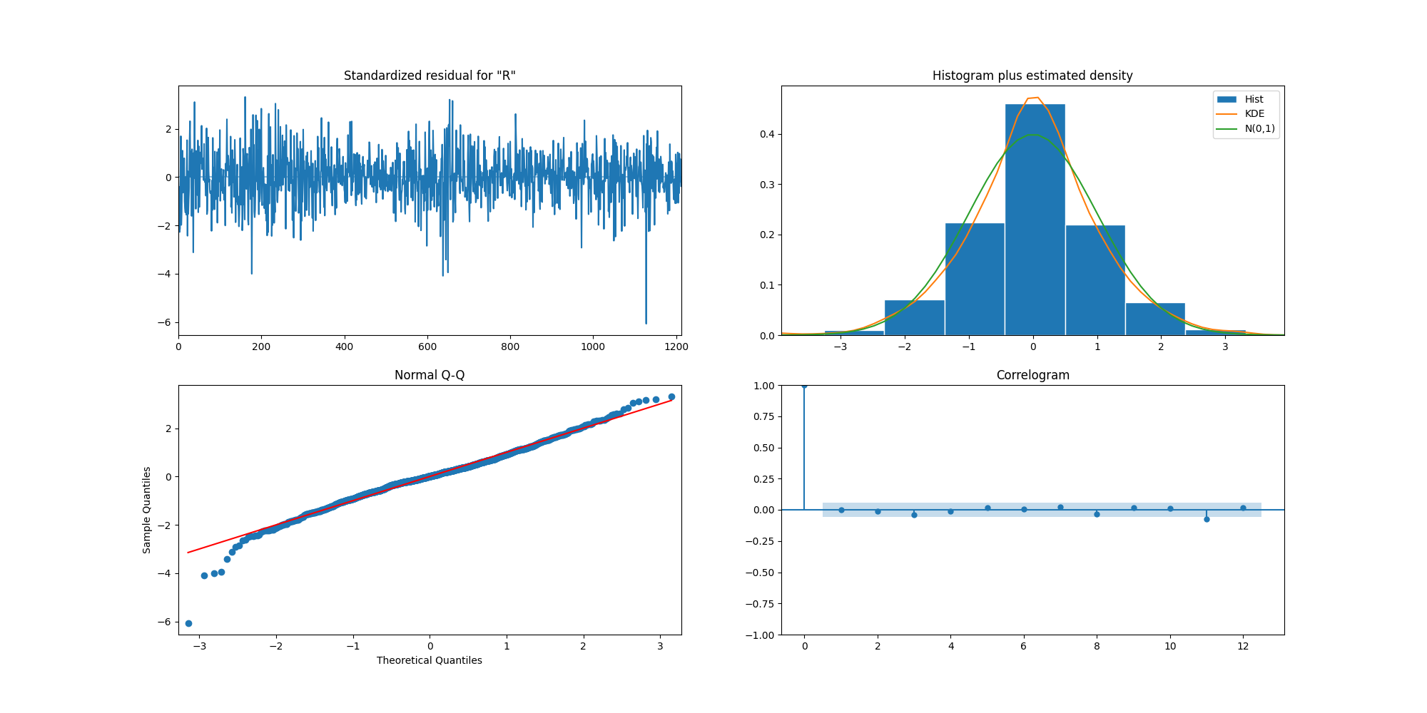
MODEL
Sarima | RESIDUAL NIFTY 2011 - 2015

Slide 22
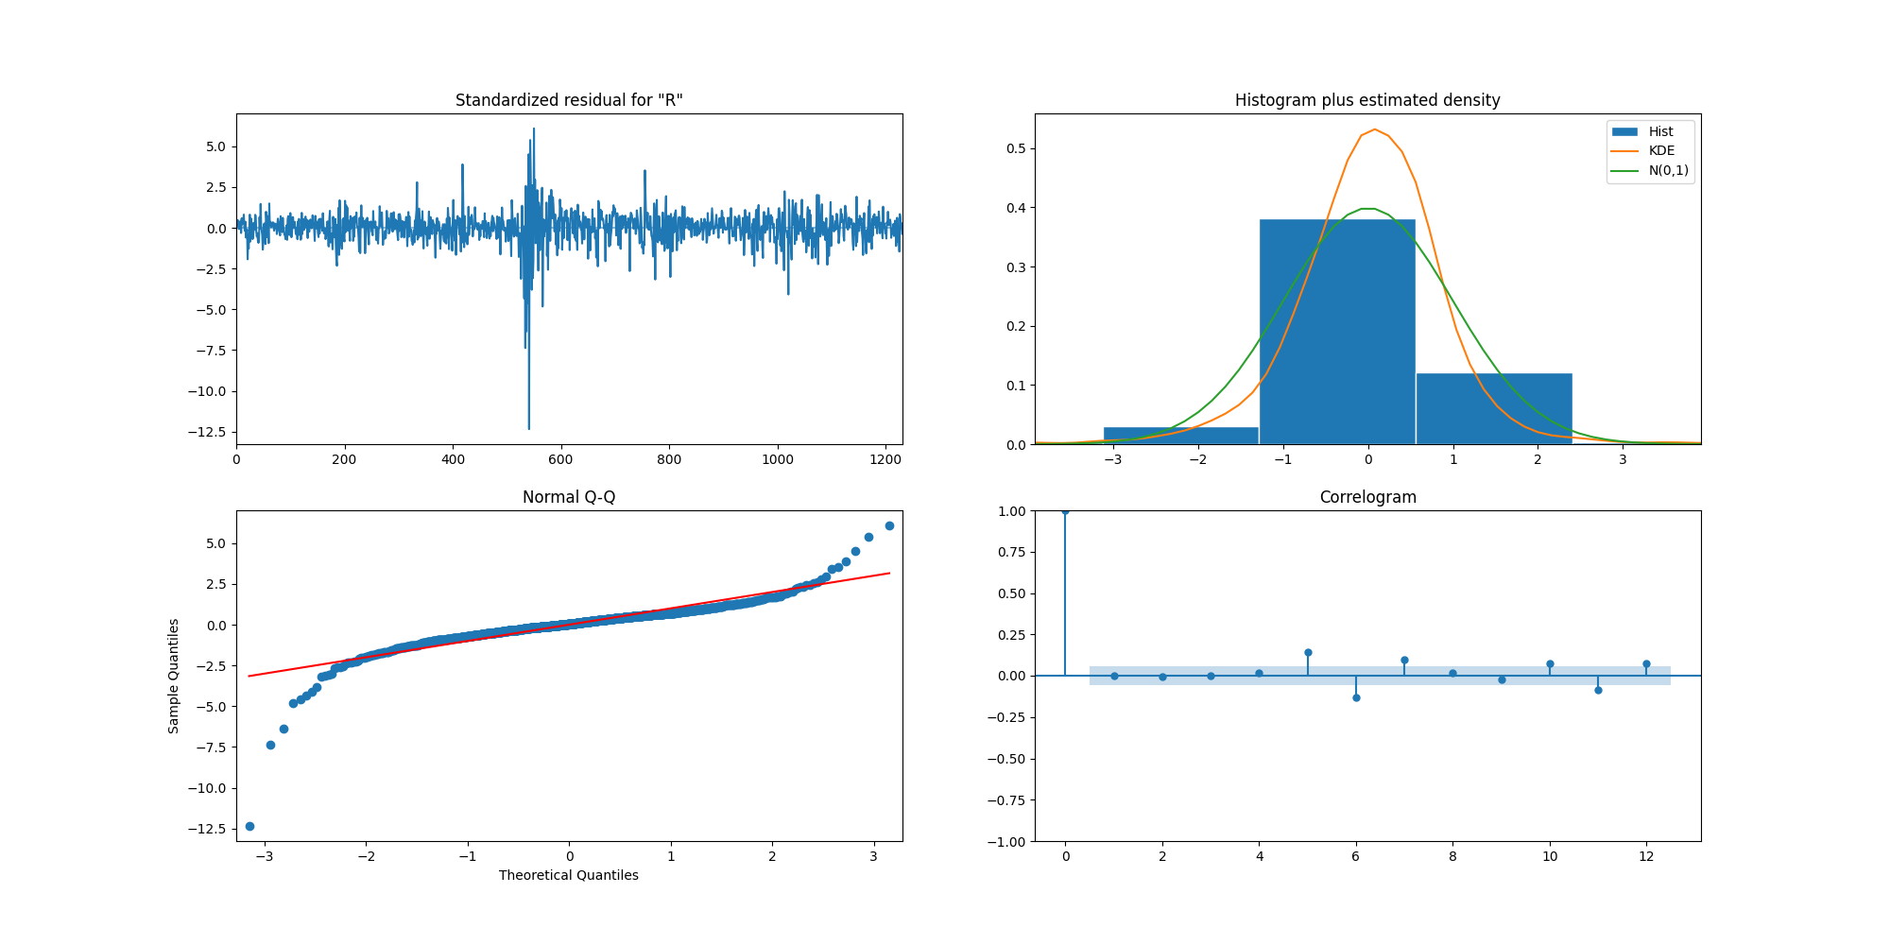
MODEL
Sarima | RESIDUAL NIFTY 2018 - 2022

Slide 23
MODEL
Sarima | Model comparison SP500
SP500 2011 - 2015
SP500 2018 - 2022
Model (SARIMAX / ARIMA) | Akaike Information Criteria ( AIC ) | Bayesian Information Criteria ( BIC )
Order = (2,0,1) Seasonal Order = (1,0,0,40) | -7265.183 | -7234.489
Order = (1,0,1) Seasonal Order = (0,0,0,0) | -7262.406 | -7241.943
Order = (1,0,2) Seasonal Order = (1,0,0,40) | -7261.006 | -7230.312
Order = (1,0,2) Seasonal Order = (0,0,0,0) | -7260.841 | -7235.263
Model (SARIMAX / ARIMA) | Akaike Information Criteria ( AIC ) | Bayesian Information Criteria ( BIC )
Order=(2,0,0) Seasonal Order = (0,0,1,50) | -7206.820 | -7181.134
Order=(2,0,1) Seasonal Order = (0,0,0,0) | -7206.617 | -7180.931
Order=(3,0,1) Seasonal Order = (0,0,0,0) | -7206.410 | -7175.586
Order=(3,0,0) Seasonal Order = (1,0,1,50) | -7204.908 | -7168.947

Slide 24
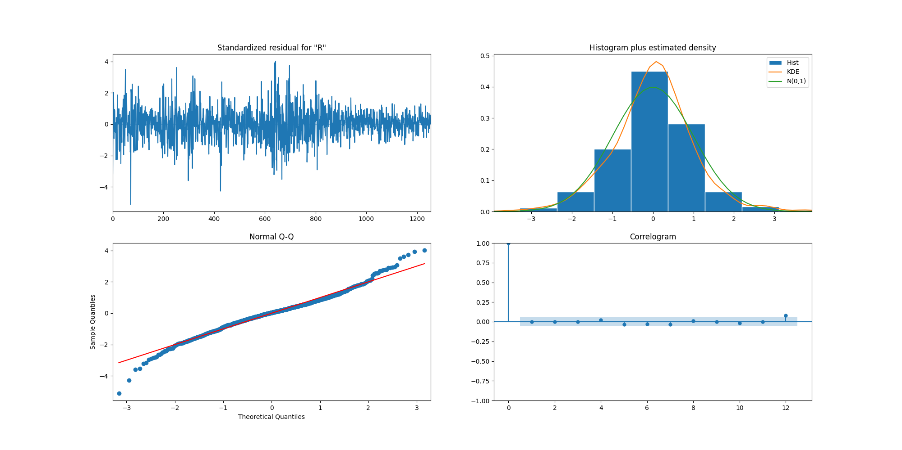
MODEL
Sarima | RESIDUAL SP500 2011 - 2015

Slide 25
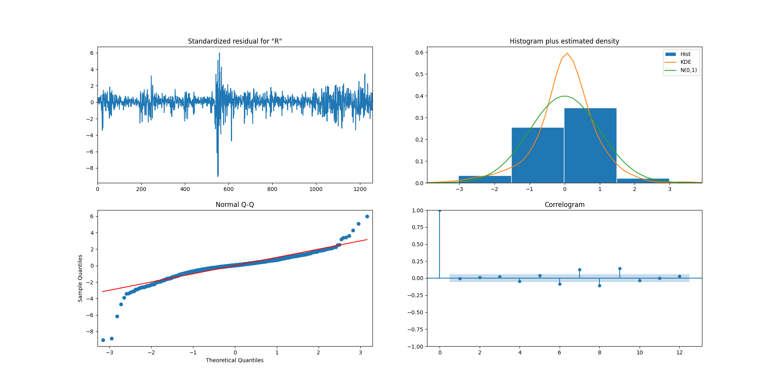
MODEL
Sarima | RESIDUAL SP500 2018 - 2022

Slide 26
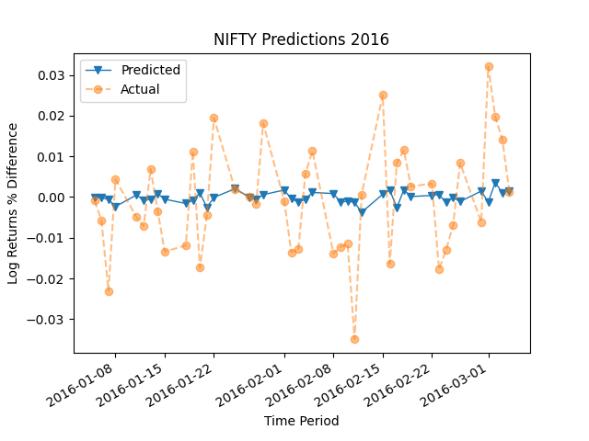
MODEL
Sarima | Dynamic plot nifty 2011 - 2015
Trend Accuracy | R2 Accuracy
58.1 % | 0.018

Slide 27
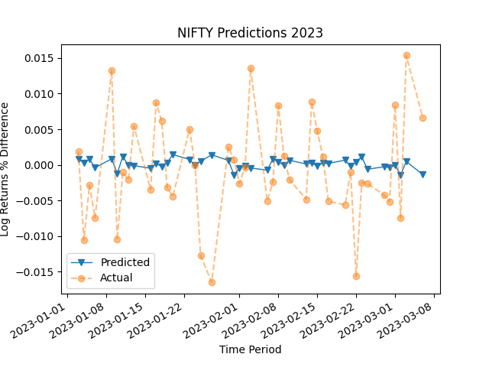
MODEL
Sarima | Dynamic plot nifty 2018 - 2022
Trend Accuracy | R2 Accuracy
50 % | - 0.027

Slide 28
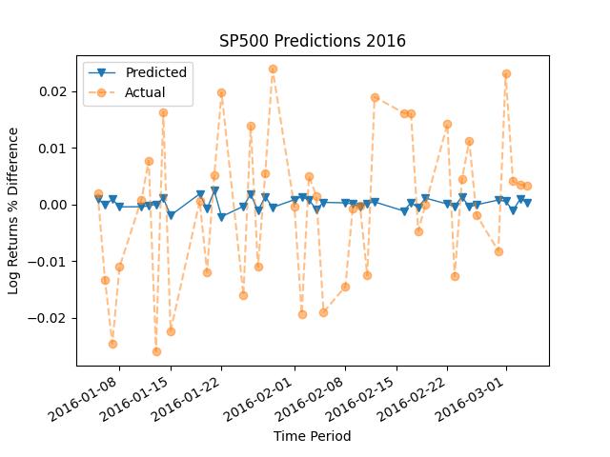
MODEL
Sarima | Dynamic plot sp500 2011 - 2015
Trend Accuracy | R2 Accuracy
57.1 % | 0.0031

Slide 29
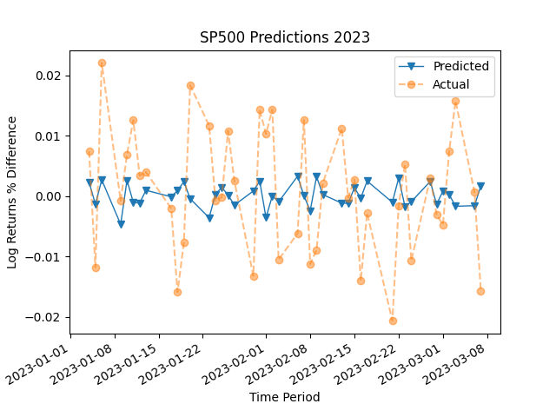
MODEL
Sarima | Dynamic plot sp500 2018 - 2023
Trend Accuracy | R2 Accuracy
51.62 % | - 0.062

Slide 30
MODEL
Sarima | results
NIFTY50
S&P500
2011-2015
2018-2022
2011-2015
2018-2022
Trend Accuracy:
58.1 %
R square value:
0.018
Trend Accuracy:
50%
R square value:
-0.027
Trend Accuracy:
57.1 %
R square value:
0.0031
Trend Accuracy:
51.52 %
R square value:
-0.062

Slide 31
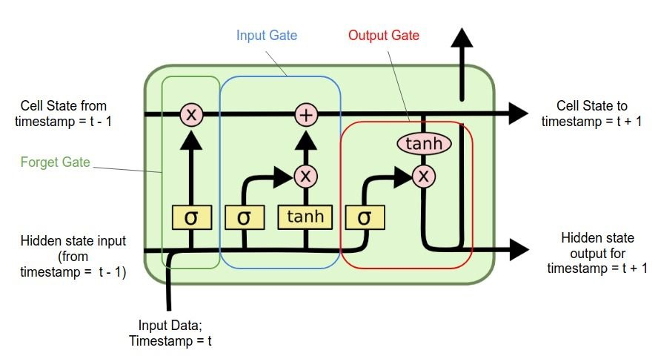
LSTM | INTRODUCTION
MODEL
LSTM is associated with Recurrent Neural Network.
Long Short-Term Memory
LSTM model is a type of recurrent neural network that can selectively store or discard information for better long-term sequence modelling.
It uses special gating mechanisms to regulate the flow of information into and out of the memory cells.

Slide 32
LSTM | FEATURE ENGINEERING
MODEL
Target
Variable
Independent Variables
Column 1 | Column 2 | Column 3 | Column 4 | Column 5 | Column 6
Day 1 | Day 2 | Day 3 | Day 4 | Day 5 | Day 6
Day 2 | Day 3 | Day 4 | Day 5 | Day 6 | Day 7
Day 3 | Day 4 | Day 5 | Day 6 | Day 7 | Day 8
Day 4 | Day 5 | Day 6 | Day 7 | Day 8 | Day 9
32

Slide 33
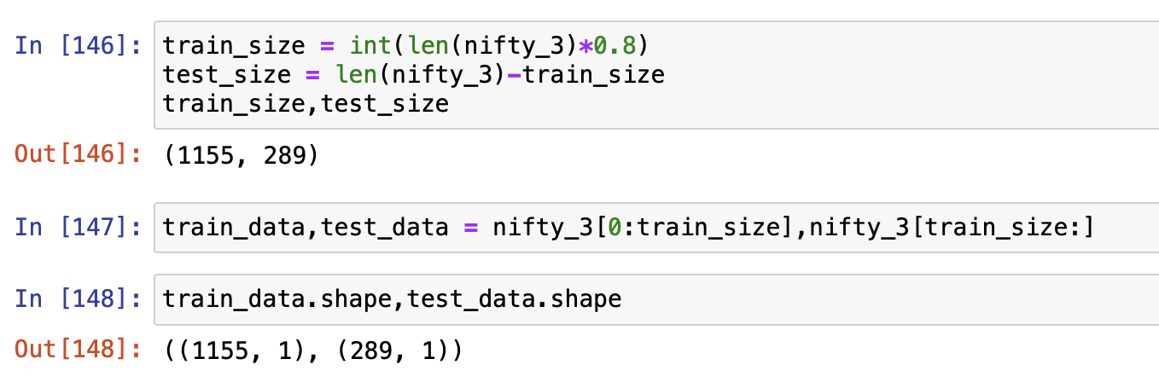
LSTM | SPLITTING TIME SERIES DATA
MODEL
Choose a cutoff point in time to separate the training data from the test data. The cutoff point should be a date that is before the time period for which you want to make predictions.
Train the model on the training data up to the cutoff point.
Evaluate the performance of the model on the test data, which consists of observations after the cutoff point.
Train Data
Validation
Test Data
Prediction
2018 to 2021
- - - - -
50 days data
2022
1 Day
Cutoff point

Slide 34
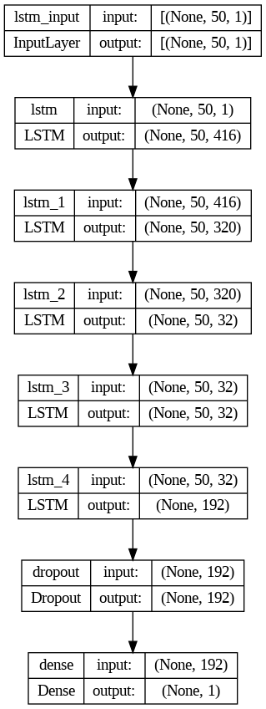
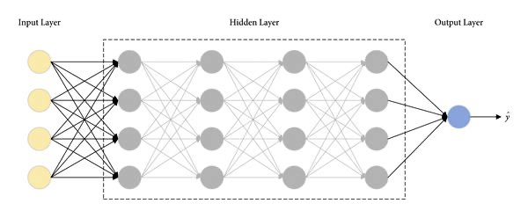
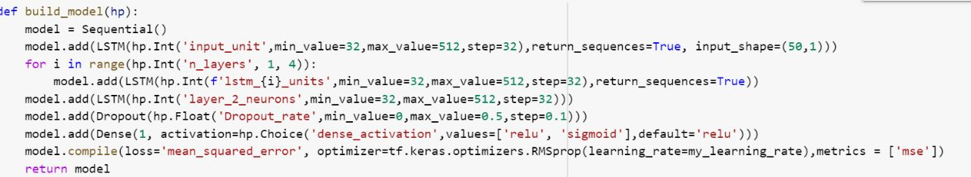
LSTM | MODEL SUMMARY
MODEL
Hyperparameters:

Slide 35
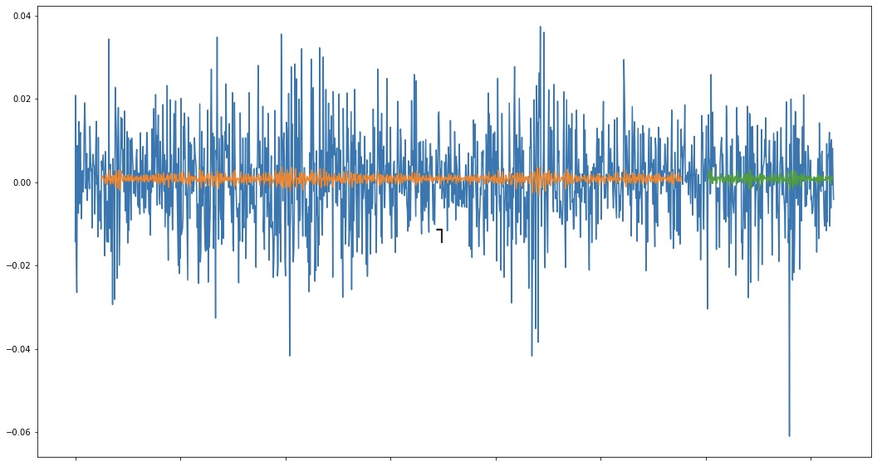
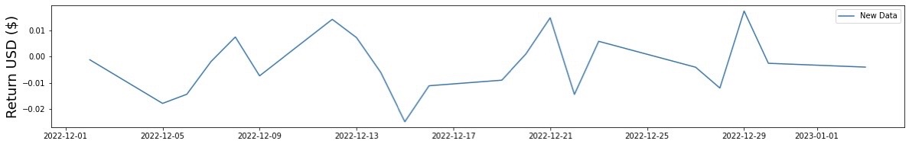
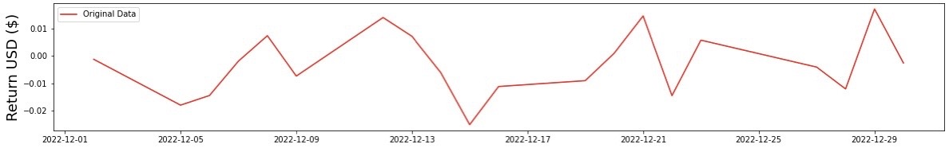
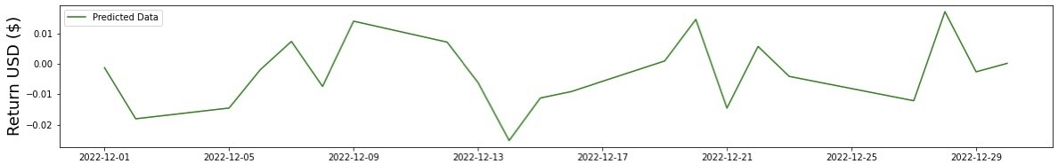
LSTM | visualization
MODEL
Forecasting
1 Day
Prediction
Return (USD)
Train data
Test data
2022-12-01
2022-12-05
2022-12-09
2022-12-13
2022-12-17
2022-12-21
2022-12-25
2022-12-29
Model Visualisation

Slide 36
LSTM | MODEL SUMMARY - DAILY
MODEL
NIFTY50
S&P500
2011-2015
2018-2022
2011-2015
2018-2022
Training Accuracy:
1
Testing Accuracy:
0.98
Training Accuracy:
1.04
Testing Accuracy:
1.78
Training Accuracy:
1.01
Testing Accuracy:
1.02
Training Accuracy:
0.97
Testing Accuracy:
1

Slide 37

Conclusion

Slide 38
MODEL RESULT SUMMARY
CONCLUSION
Statistical test
SARIMA / ARIMA
LSTM
Both market is well-developed and very efficient.
Runs test and variance ratio test may have different results because of using different data features , but both capture the same characteristics of data.
Runs tests and variance ratio tests characterize the US: S&P500 index as a more mean-reverting market and India: Nifty-50 index be more trending in both period.
In the testing data, the stock returns don't fit well. Although the models are capable of capturing trends.
Nifty50 performs better than SP500 when it comes to fit.
Nifty50 and S&P500 models capture trends to a certain extent for 2011 - 2015.
Nifty50 and S&P500 models perform even worse than even the basic mean predictions for the 2018 – 2022.
In spite of the model's low accuracy, it lends some support to the random walk theory. Our predictions can be improved, however, if we identify trends in stock returns.
Over seven years, we found no significant difference in market efficiency between the S&P500 and the Nifty50.
Our analysis suggests that Nifty50 was more predictable seven years ago than it is now, while the S&P500 is currently more predictable than it was in the past.

Slide 39

THANKS FOR YOUR ATTENTION

